Slide 2
Javelin WH/Gold
Features
Body Finish | WH/Gold
Blade Finish | NA
Blade Material | NA
Diameter | NA
Height | 40”
Standard Down Rod | NA
RPM | NA
Motor | Compressor
MRP Rs | 26000

Slide 3
Helix WH/Silver
Features
Body Finish | WH/Silver
Blade Finish | NA
Blade Material | NA
Diameter | NA
Height | 41"
Standard Down Rod | NA
RPM | 205
Motor | Compressor
MRP Rs | 26000

Slide 4
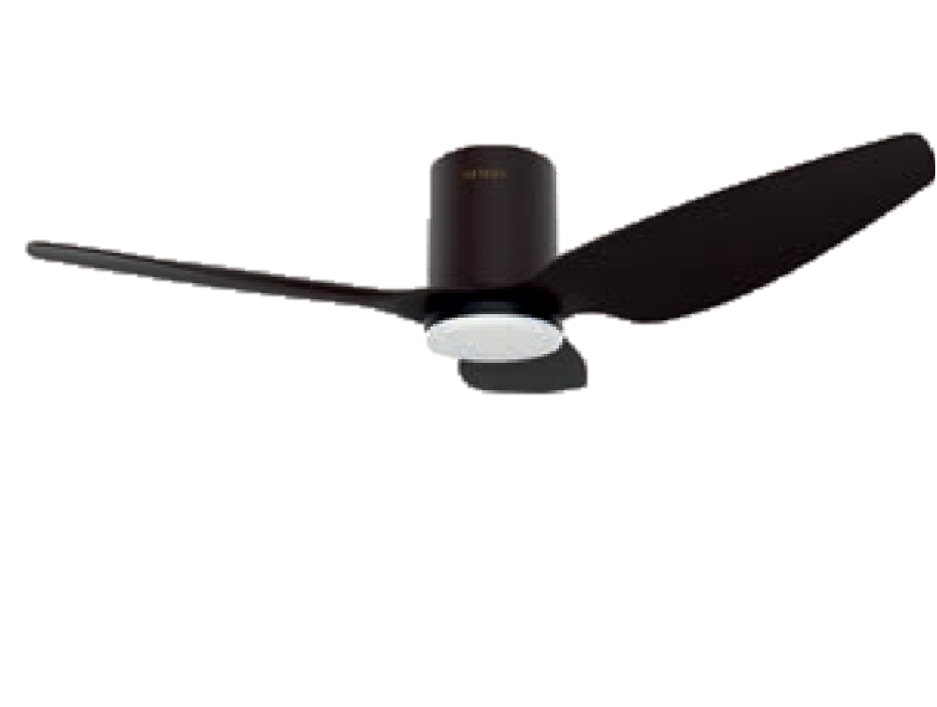
Jill RB/MW
Features
Body Finish | RB/MW
Blade Finish | Brown/MW
Blade Material | ABS
Diameter | 46"
Height | 10"
Standard Down Rod | NA
RPM | 210
Motor | DC
MRP Rs | 28000

Slide 5
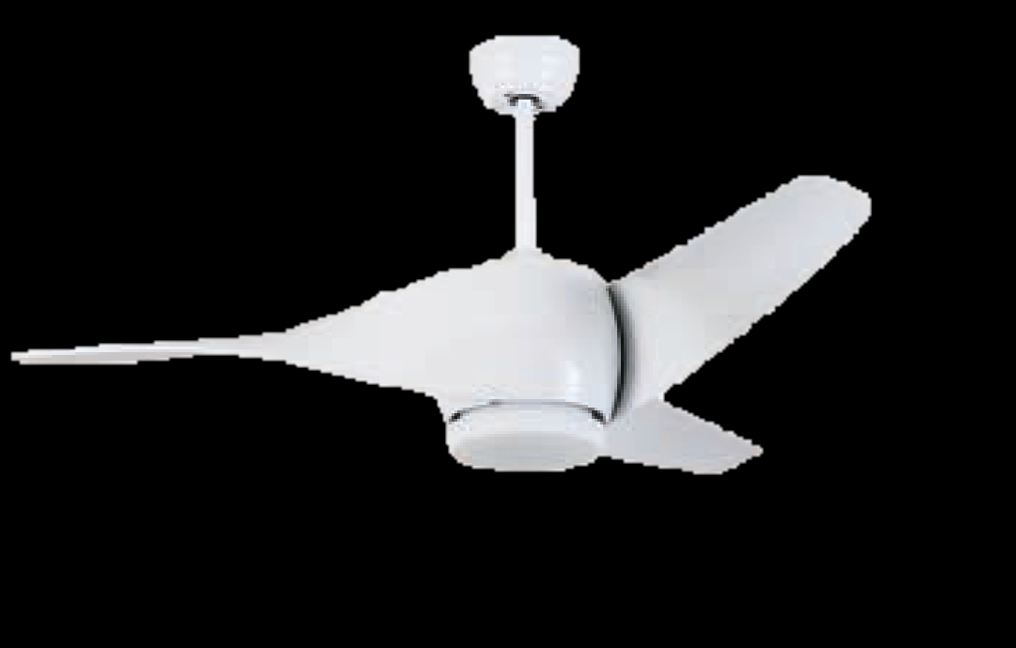
Artesia WD/MW
Features
Body Finish | BW/MW
Blade Finish | BW/MW
Blade Material | ABS
Diameter | 52"
Height | 22"
Standard Down Rod | 6"
RPM | 144
Motor | AC
MRP Rs | 34000

Slide 6
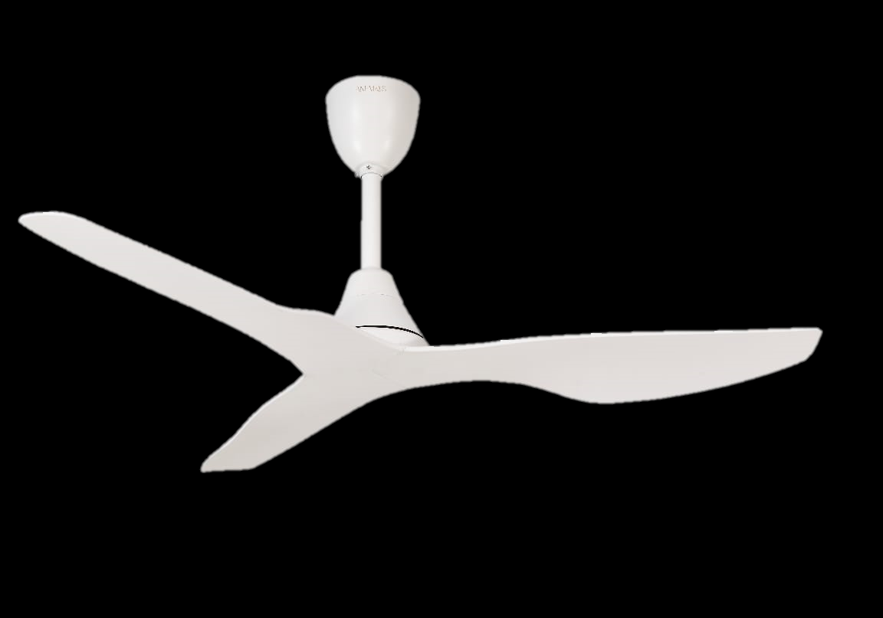
Simplicity MB/MW
Features
Body Finish | Matte Black/Matte White
Blade Finish | Distressed Koa/Matte White
Blade Material | ABS
Diameter | 45"
Height | 16”
Standard Down Rod | 6”
RPM | 210
Motor | DC
MRP Rs | 31000/29000

Slide 7
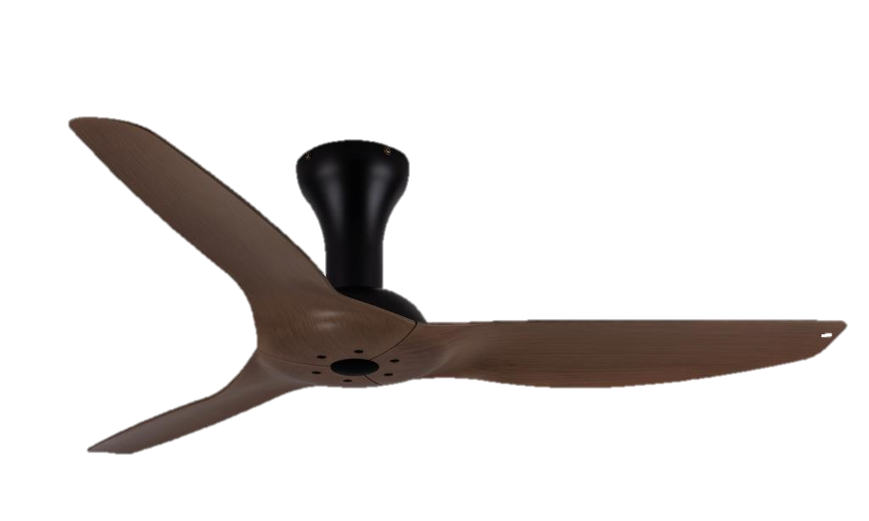
Pancake MB/MW
Features
Body Finish | MB/MW
Blade Finish | Dark Mahogany/MW
Blade Material | ABS
Diameter | 52"
Height | 12"
Standard Down Rod | NA
RPM | 215
Motor | DC
MRP Rs | 29500

Slide 8
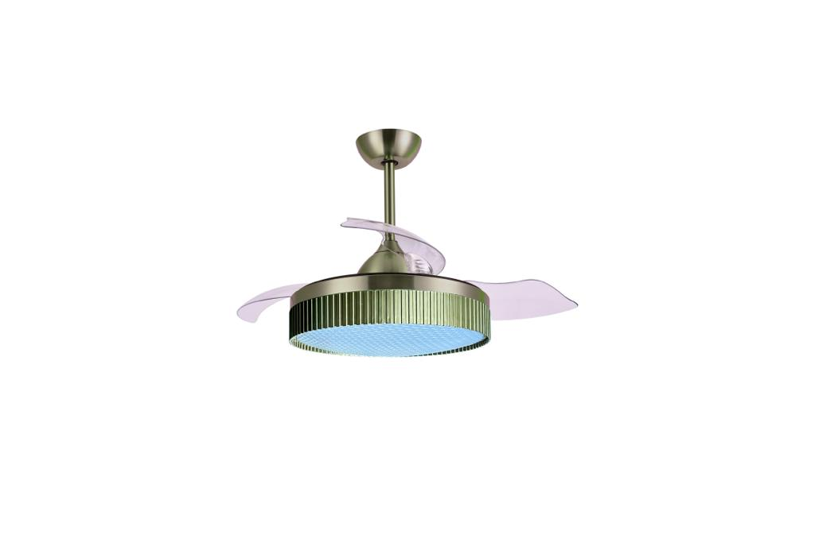
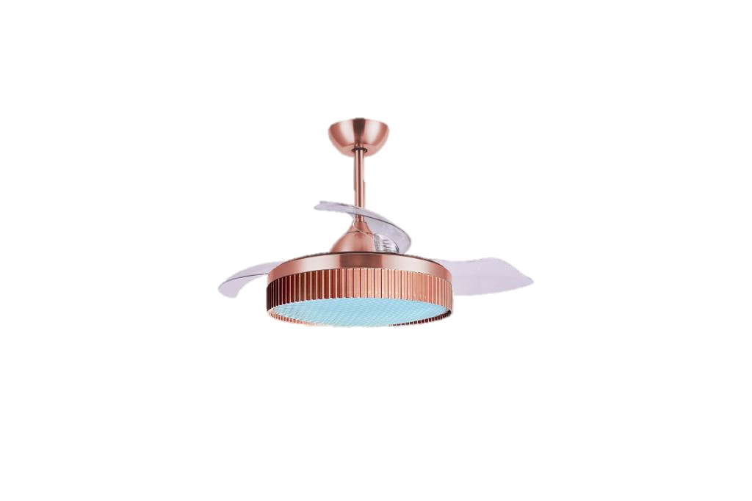
Tucker RC/AB/BN
Features
Body Finish | BN/RC/AB
Blade Finish | Clear/Brown/Brown
Blade Material | ABS
Diameter | 42"
Height | 20.5"
Standard Down Rod | 6"
RPM | 230
Motor | DC
MRP Rs | 32000

Slide 9
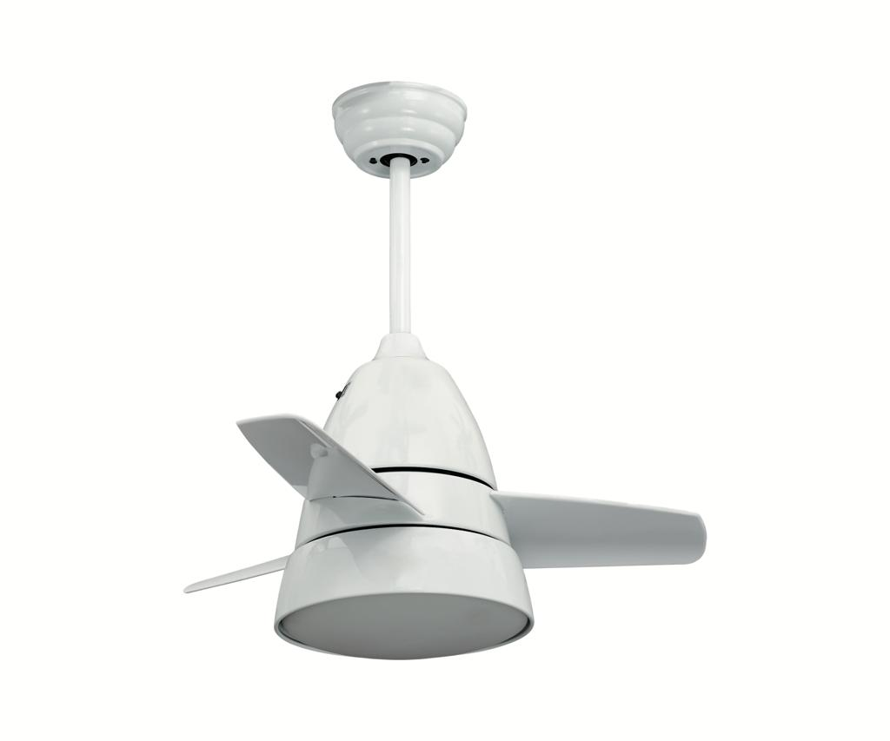
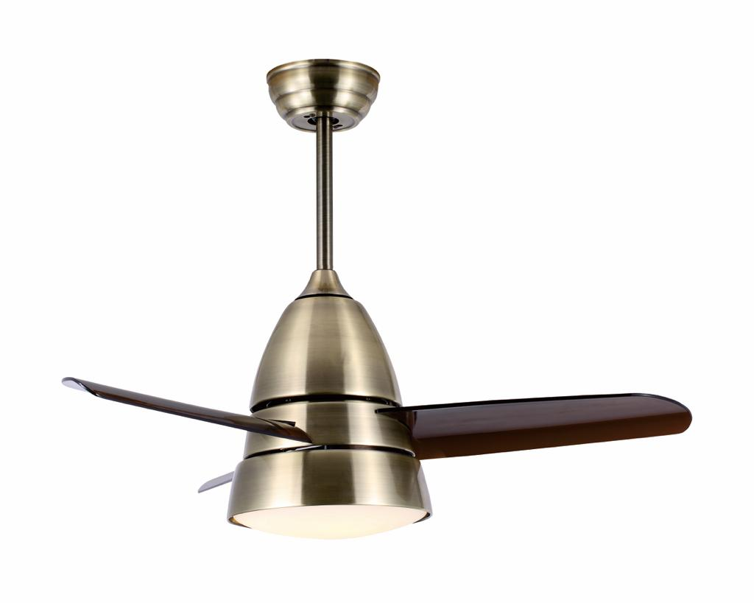
Goblin BN/AB/MW
Features
Body Finish | BN/MW/AB
Blade Finish | Clear/MW/Brown
Blade Material | ABS
Diameter | 36"
Height | 24"
Standard Down Rod | 6"
RPM | 214
Motor | AC
MRP Rs | 26000

Slide 10
Nebula
Features
Body Finish | Black
Blade Finish | Black
Blade Material | ABS
Diameter | 30"
Height | 21"
Standard Down Rod | 8"
RPM | 600
Motor | D C Motor
MRP Rs | 48000

Slide 11
Octave
Features
Body Finish | Black
Blade Finish | Coffee
Blade Material | ABS
Diameter | 33"
Height | 19.5"
Standard Down Rod | 8"
RPM | 600
Motor | D C Motor
MRP Rs | 48000

Slide 12
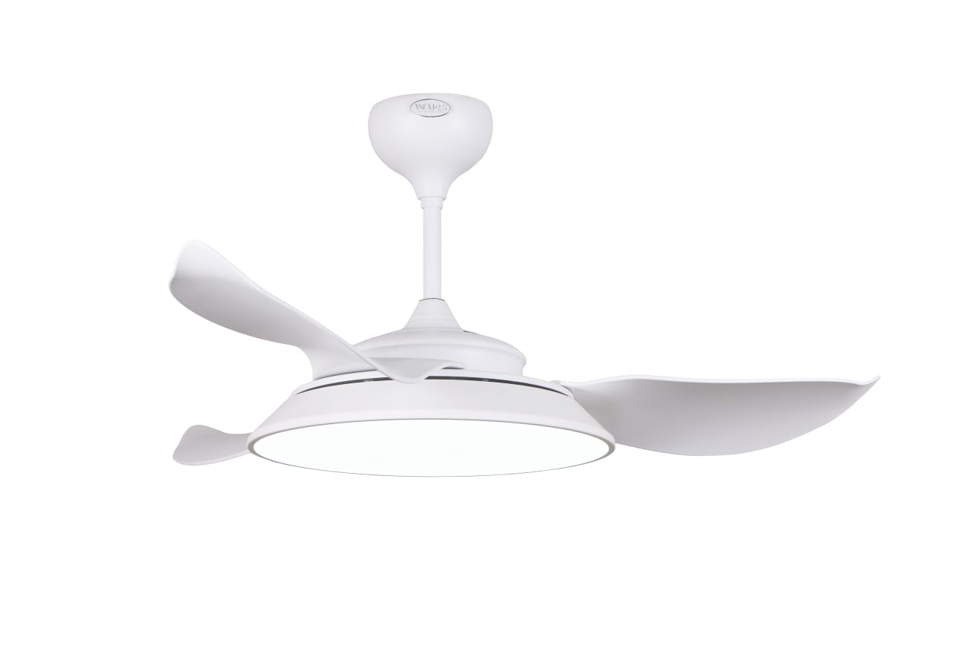
Tryst
Features
Body Finish | AB/MW
Blade Finish | Coffee/MW
Blade Material | ABS
Diameter | 42"
Height | 17"
Standard Down Rod | 10"
RPM | 205
Motor | BLDC
MRP Rs | 35000

Slide 13
Aerial
Features
Body Finish | White
Blade Finish | White
Blade Material | ABS
Diameter | 24"
Height | 4.5"
Standard Down Rod | NA
RPM | NA
Motor | D C Motor
MRP Rs | 37000

Slide 14
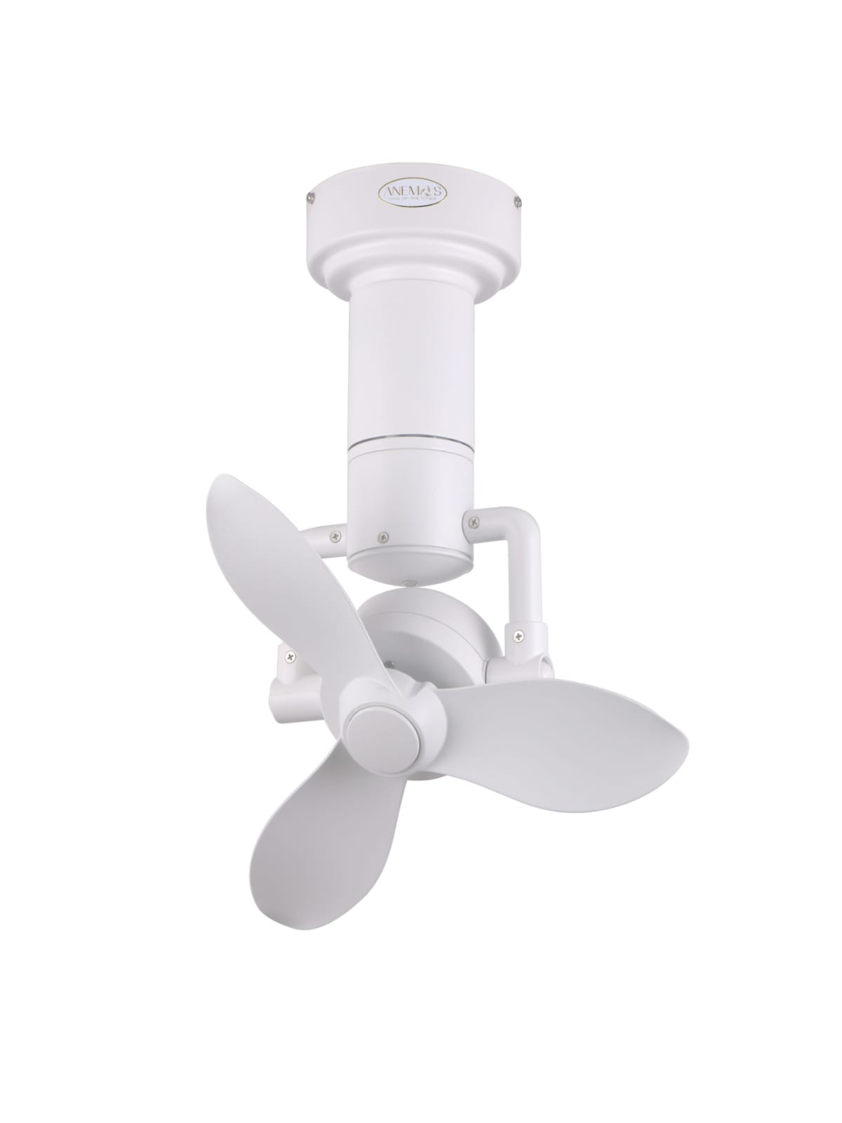
Foxy Ceiling Fan
Features
Body Finish | Sandy Gold/MW
Blade Finish | SG/MW
Blade Material | ABS
Diameter | 16"
Height | 21“ & 31”
Overall Length | 5” & 8”
RPM | 950
Motor | BLDC
MRP Rs | 34000

Slide 15
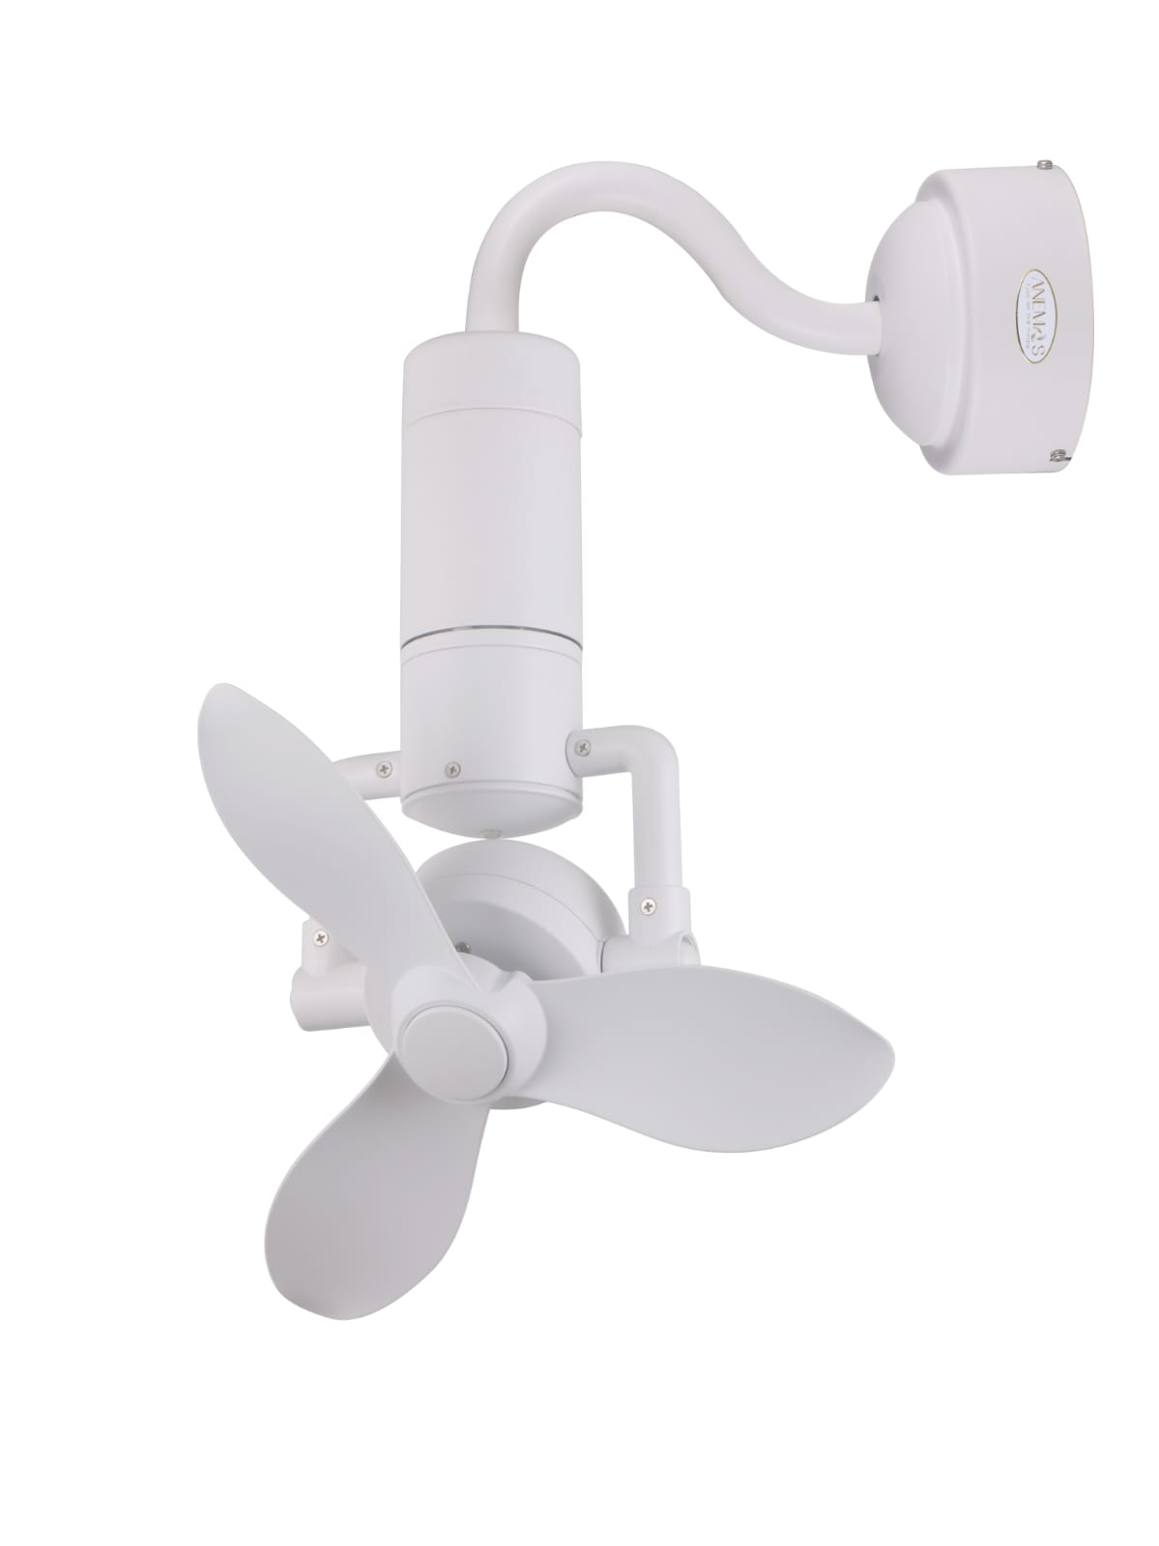
Foxy Wall Fan
Features
Body Finish | Sandy Gold/MW
Blade Finish | SG/MW
Blade Material | ABS
Diameter | 16"
Height | 21“ & 21”
Overall Length | 16”
RPM | 950
Motor | BLDC
MRP Rs | 34000

Slide 16
Splendid
Features
Body Finish | White
Blade Finish | White
Blade Material | ABS
Diameter | 52"
Height | 18"
Standard Down Rod | 8"
RPM | 180
Motor | D C Motor
MRP Rs | 29500

Slide 17
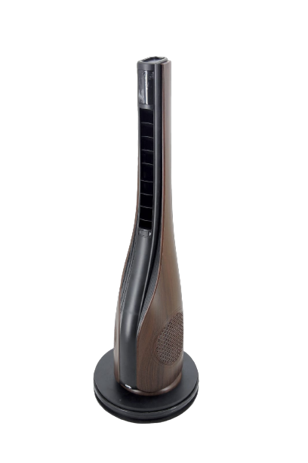
Swan
Features
Body Finish | Dark Walnut / White
Blade Finish | NA
Blade Material | ABS
Diameter | NA
Height | 40"
Standard Down Rod | NA
RPM | NA
Motor | Compressor
MRP Rs | 22000

Slide 18
THANK YOU
&
MANY MORE TO COME
THANK YOU
MANY MORE COMING

